Slide 1
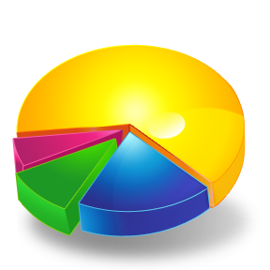
Hotel Revenue Management
Part 2 (PPT 1)
“You can’t manage what you cannot measure”
“The only way to tell if a hotel property underperforms or not is to calculate some key indicators that provide a meaningful measurement of a hotel’s performance.”
Measurement

Slide 2
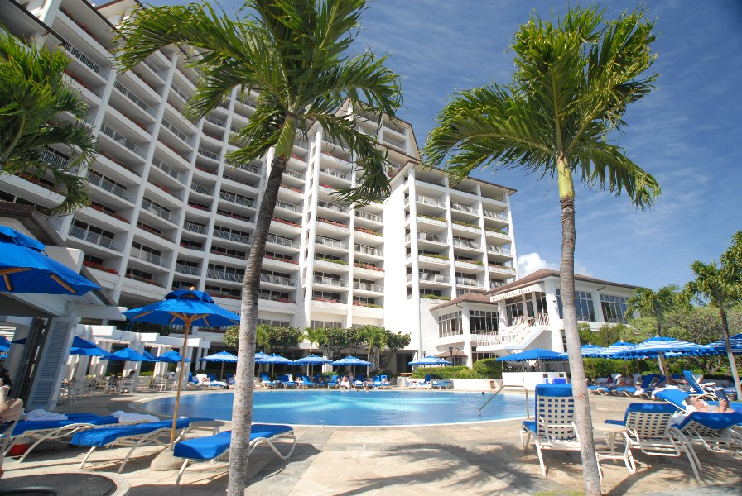
Look at your historical data to improve profitability
New hotels should look at comparable hotels

Slide 3
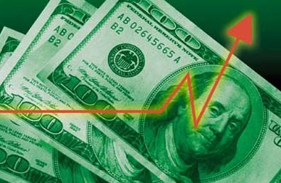
Revenue
Quarterly, monthly, weekly, or daily
To have integrity, be consistent with working with data (e.g. room nights, number of guests, etc)
Compare your records with your historical data or with your budget.
Know your revenue in details (e.g. revenue from other departments, even revenue from different room types)

Slide 4

Available Rooms
Occupied Rooms
Room Revenue

Slide 5
Available Rooms Occupied Rooms Room Revenue
Available Rooms
Occupied Rooms
Room Revenue
Occupancy Percent
Revenue Per Available Room (RevPAR)
Average Daily Rate (ADR)

Slide 6
Occupancy % = Rooms Occupied ÷ Rooms Available
If your hotel has 120 rooms and you sold 60 last night, your occupancy is:
60 / 120 or 50%
You sold half your rooms

Slide 7
Average Daily Rate (ADR) = Room Revenue ÷ Occupied Rooms
If your hotel had $2,038 in Room Revenue last night, and you sold 14 rooms, you had an ADR of $145.57
2,038 / 14 is $145.57
The Average Guest paid $145.57

Slide 8
Other measures …consistency is the key!
ProPAR = Profit Per Available Room
REVPAG = Revenue Per Available Guest
    Total revenue / number of guests
Challenges with REVPAG:
    Integrity of the house count
    F&B revenues from outside customers
    Revenues from banquets
TotRevPASF (Total revenue per available square foot)

Slide 9
Measurement Challenges
Measuring performance before and after the implementation of RM.
Comparing results to another hotel.
Comparing results with market averages.

